Slide 1
Centro Formación
SOMORROSTRO

Slide 2
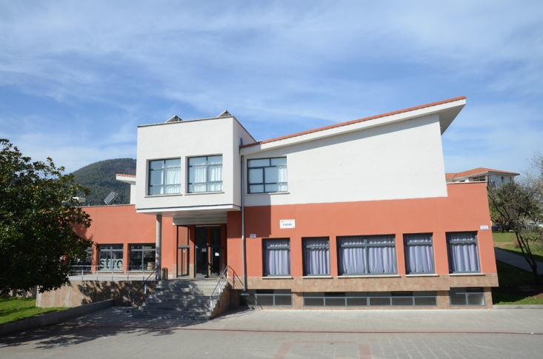
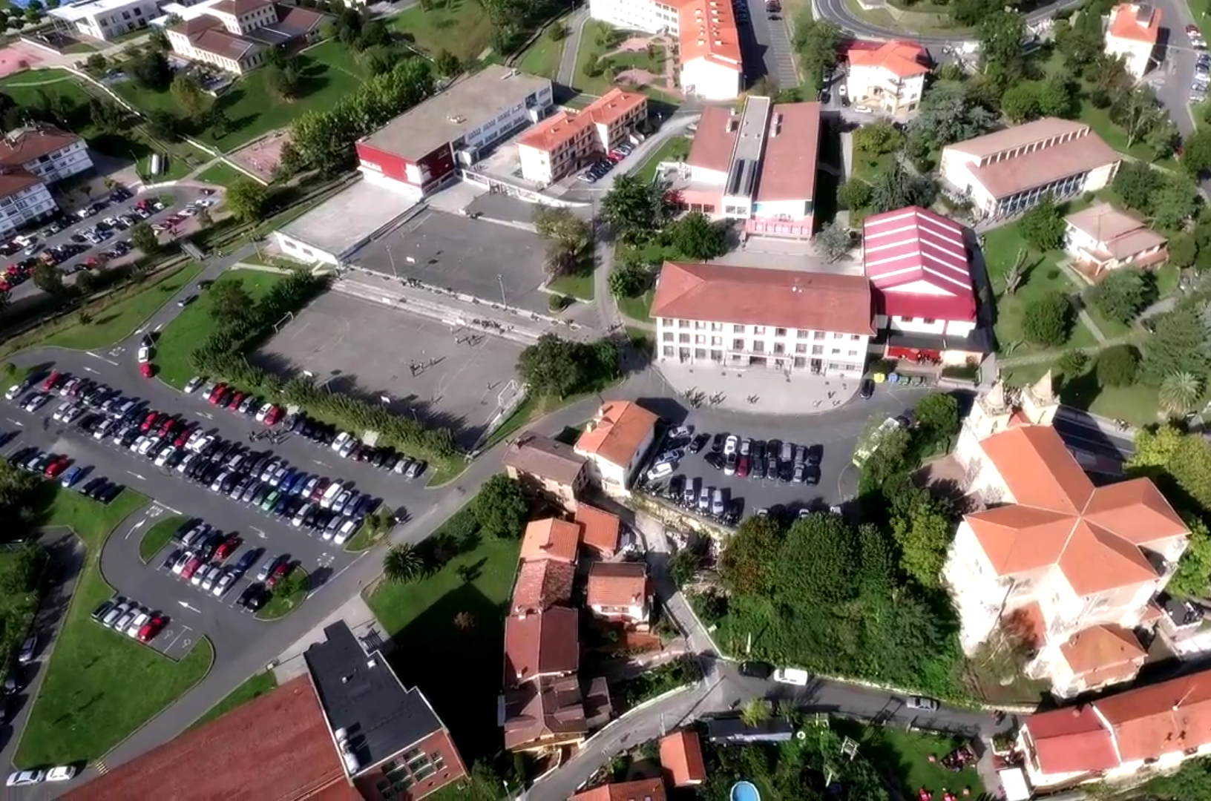
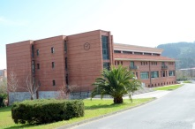
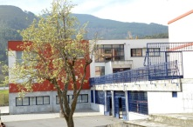
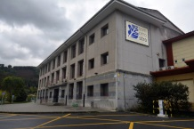
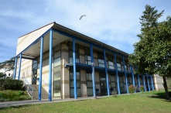
Our campus
Surface: 75.000 m2
Buildings: 15.000 m2

Slide 3
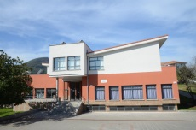
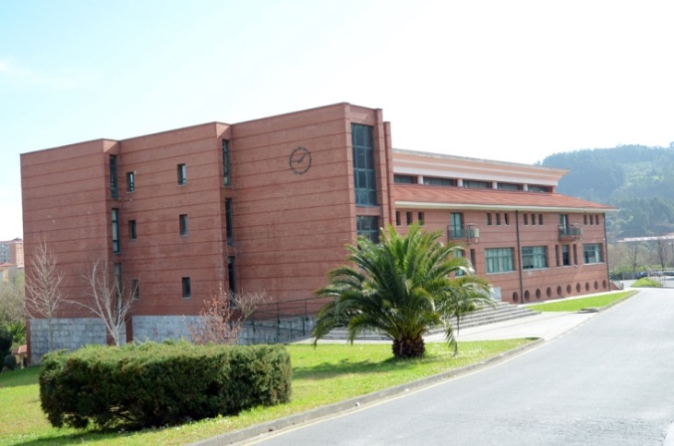
Our campus
Surface: 75.000 m2
Buildings: 15.000 m2

Slide 4
Our campus
Surface: 75.000 m2
Buildings: 15.000 m2

Slide 5
Our campus
Surface: 75.000 m2
Buildings: 15.000 m2

Slide 6
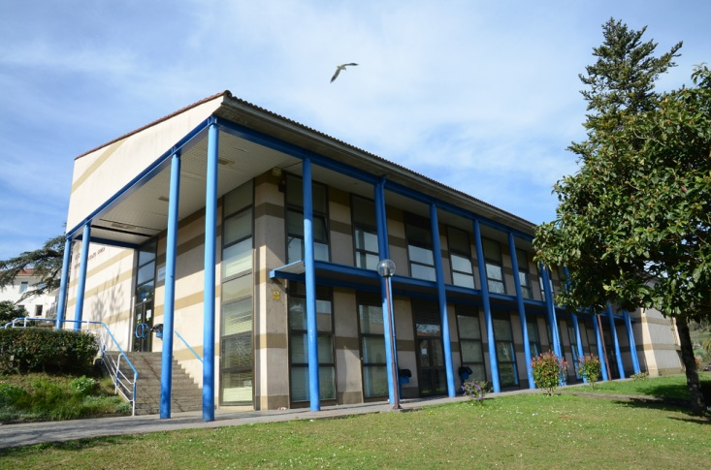
Our campus
Surface: 75.000 m2
Buildings: 15.000 m2

Slide 7
Year 2020/2021
OFFICIAL TRAINING
VET FOR EMPLOYMENT
Secondary: 438
Bachillerato: 387
VET: 1278 (Basic VET, VET & Higher VET)
Training for active and unemployed people
Professional Certificates
Training on demand by companies
01
02
TOTAL: 2.103 students
More than 3.500 students

Slide 8
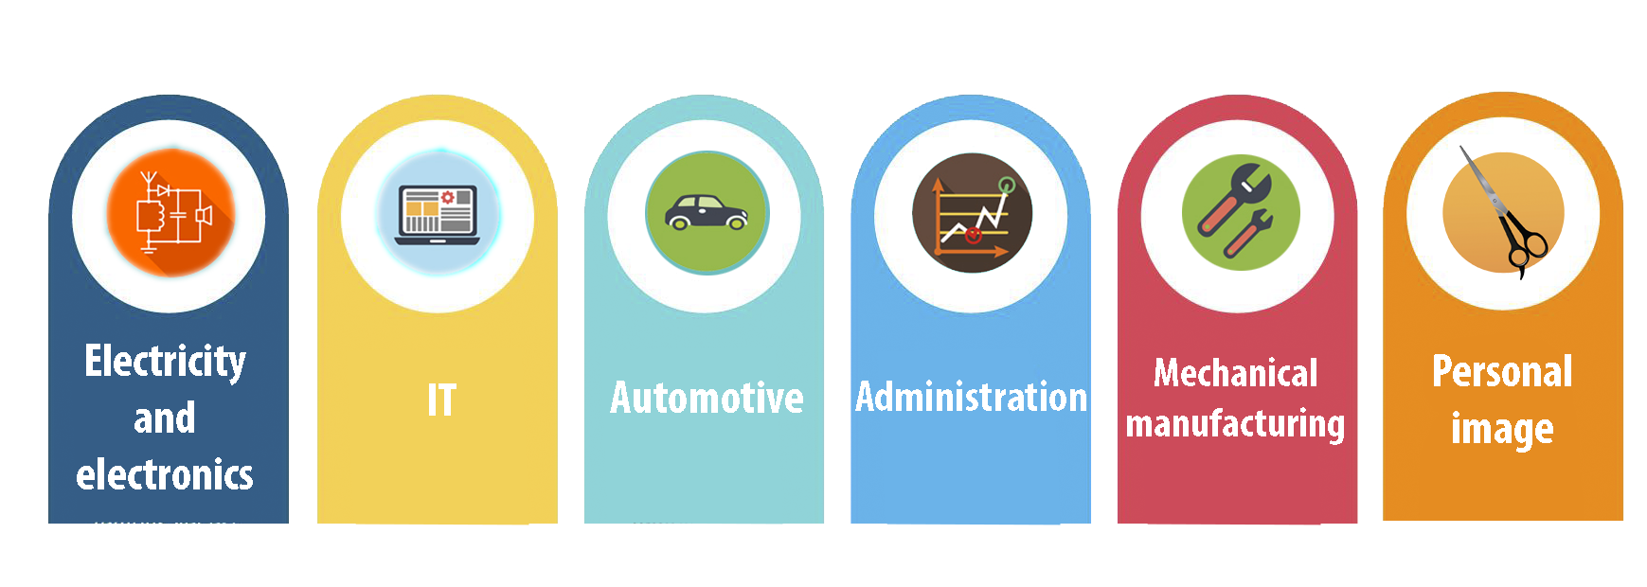
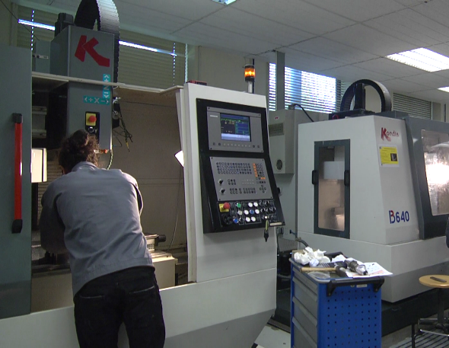
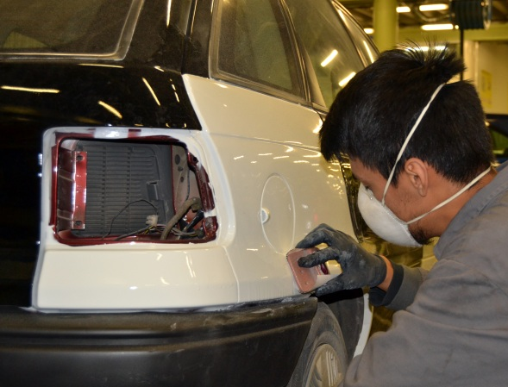
Main training areas

Slide 9
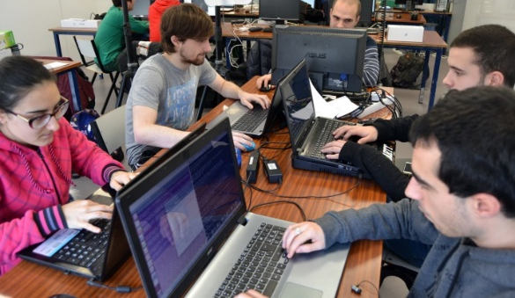
Commitment to New Methodologies
Challenge-based intermodular cooperative work (ETHAZI)
Sustainable human development
Talent generation and conservation
Learning
and
Service
Values 4.0
Social Transformation
New Technologies 4.0

Slide 10
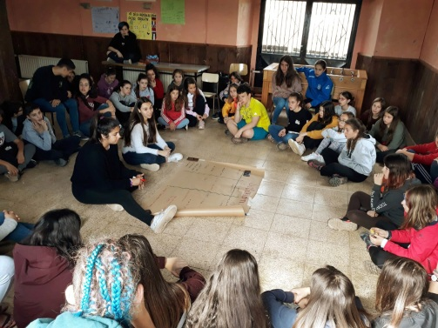
People & Values
GAZTE TALDEAK
GAZTE TALDEAK
FAIR TRADE
VOLUNTEERING
CO-EDUCATION

Slide 11
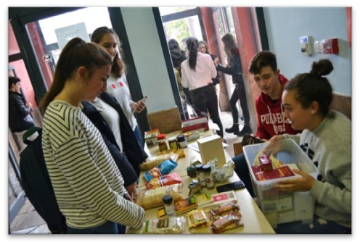
People & Values
GAZTE TALDEAK
FAIR TRADE
FAIR TRADE
VOLUNTEERING
CO-EDUCATION

Slide 12
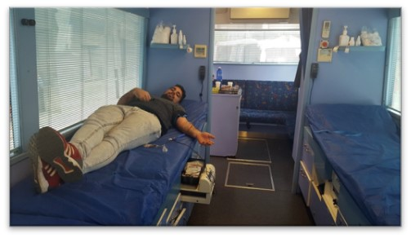
People & Values
GAZTE TALDEAK
VOLUNTEERING
FAIR TRADE
VOLUNTEERING
CO-EDUCATION

Slide 13
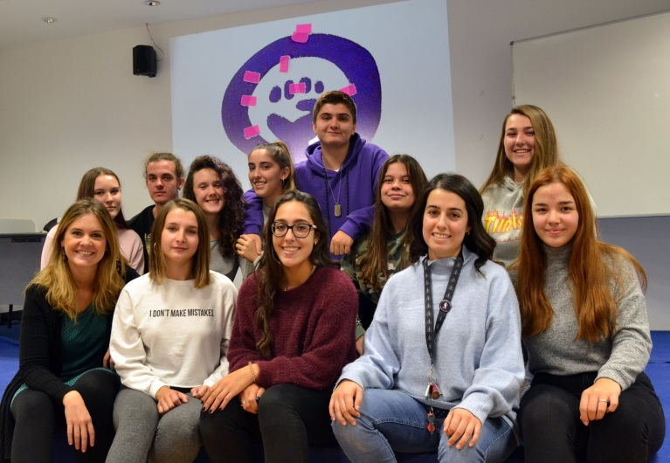
People & Values
GAZTE TALDEAK
CO-EDUCATION
FAIR TRADE
VOLUNTEERING
CO-EDUCATION

Slide 14
Steps towards employment
DUAL VET
CENTRE FOR ACCESS TO EMPLOYMENT
CENTRE-COMPANY SHIFT TRAINING
MORE THAN 1800 JOB OFFERS EVERY YEAR
In the 19/20 academic year, more than 100 DUAL training plans were carried out among our VET students (Basic, Intermediate and Higher VET). 57% in the CONTRACT modality and 43% with GRANT.
Objectives:
The labour insertion of the students who finish their training
Commitment to the employment of young people (LEHEN AUKERA))
Collaborate in the insertion of the most difficult sectors in the labour market.

Slide 15
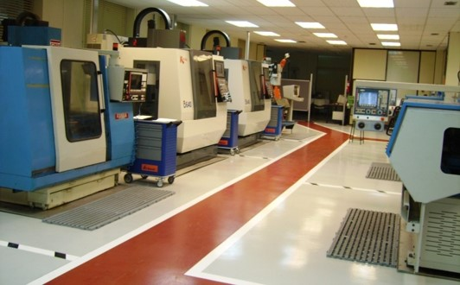
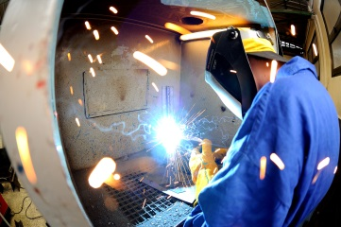
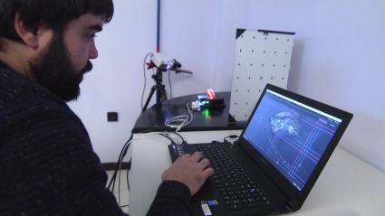
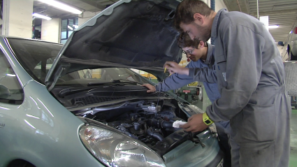
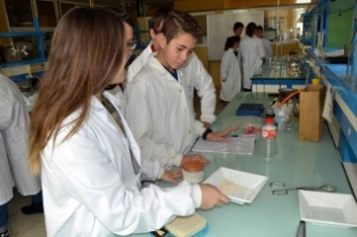
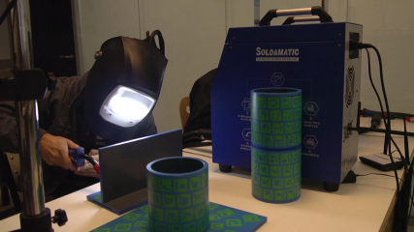
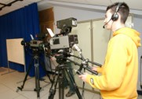
Our classrooms
CNC Classroom

Slide 16
Our classrooms
Welding workshop

Slide 17
Our classrooms
Fab Lab

Slide 18
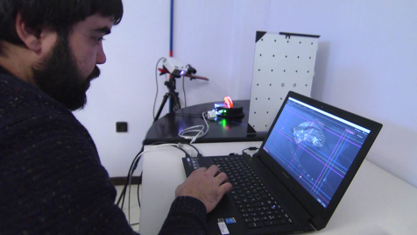
Our classrooms
Automotive Workshop

Slide 19
Our classrooms
The Lab

Slide 20
Our classrooms
Hairdresser

Slide 21
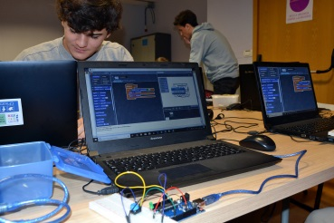
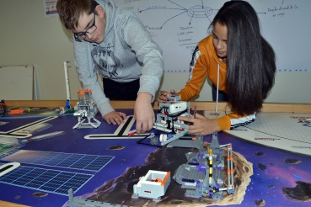
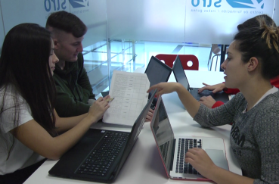
Our classrooms
Virtual Welding

Slide 22
Our classrooms
Radio & TV room

Slide 23
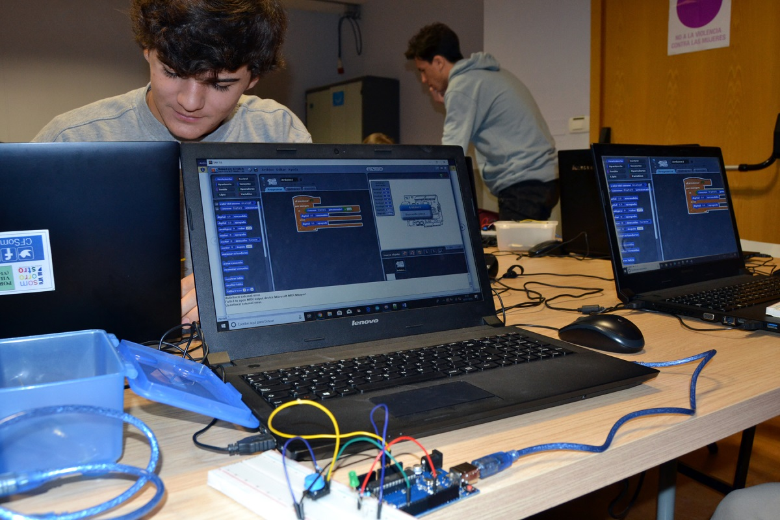
Our classrooms
Technology Bachillerato

Slide 24
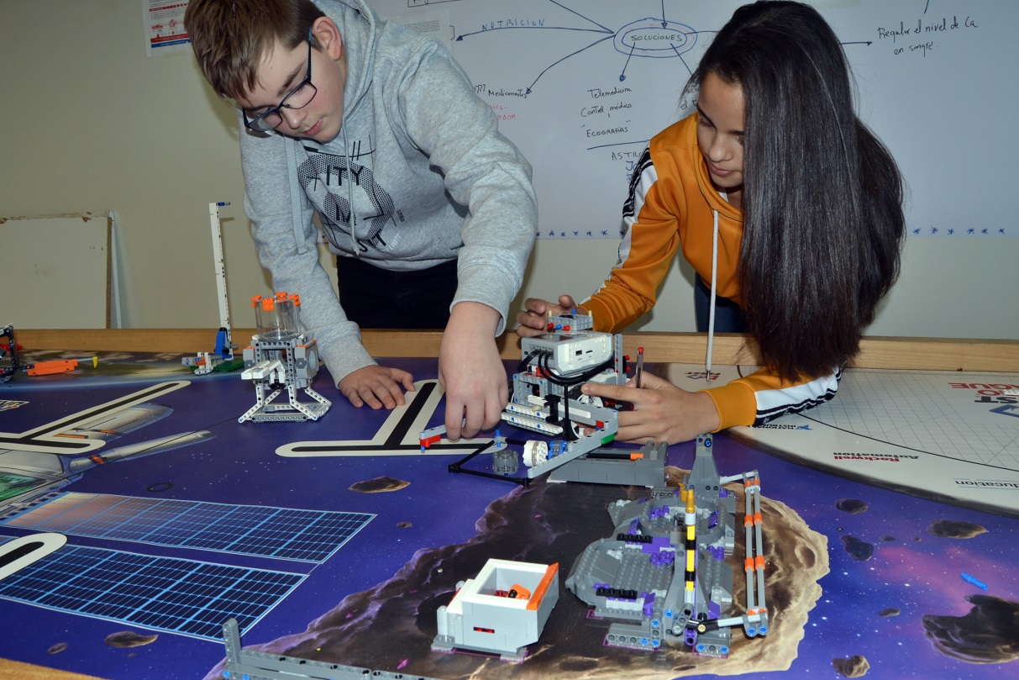
Our classrooms
LEGO Room

Slide 25
Our classrooms
Ethazi corner

Slide 26
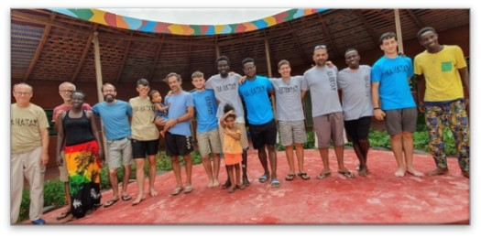
Complementary activities
RECYCLING WITH HAHATAY

Slide 27
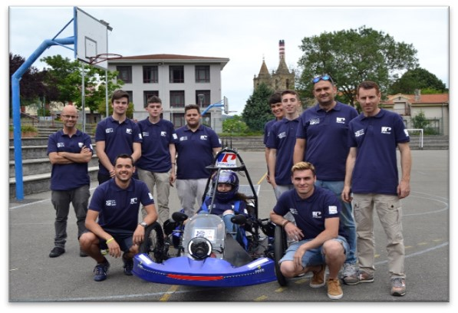
Complementary activities
RECYCLING WITH HAHATAY
EUSKELEC PROJECT

Slide 28
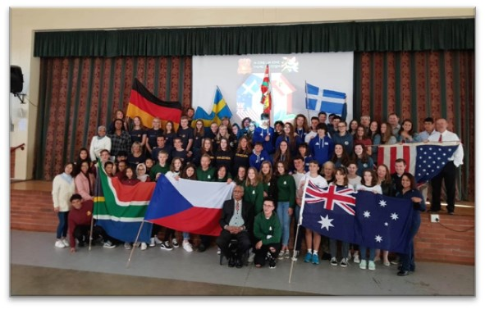
Complementary activities
RECYCLING WITH HAHATAY
EUSKELEC PROJECT
GLOBAL CLASSROOM PROJECT

Slide 29
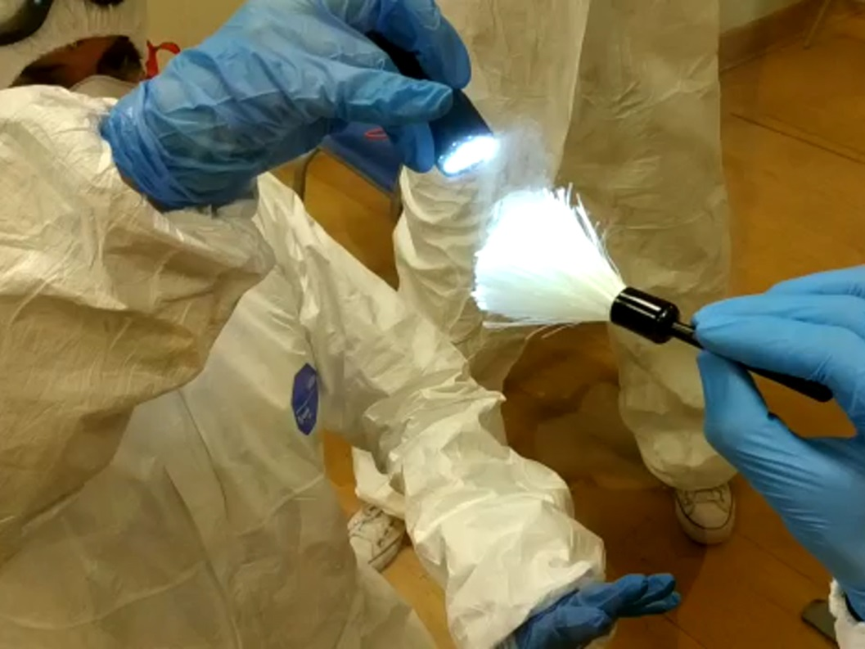
Complementary activities
RECYCLING WITH HAHATAY
EUSKELEC PROJECT
GLOBAL CLASSROOM PROJECT
FORENSIC SCIENCE

Slide 30
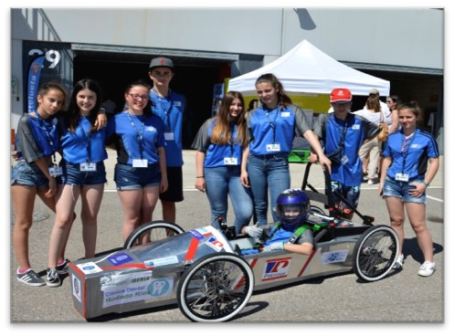
Complementary activities
RECYCLING WITH HAHATAY
EUSKELEC PROJECT
GLOBAL CLASSROOM PROJECT
FORENSIC SCIENCE
GREENPOWER PROJECT

Slide 31
Complementary activities
INTERCAMBIOS DE ALUMNADO
GLOBAL CLASSROOM
EUSKELEC
RECICLANDO CON HAHATAY
FORENSIC SCIENCE
GREENPOWER

Slide 32
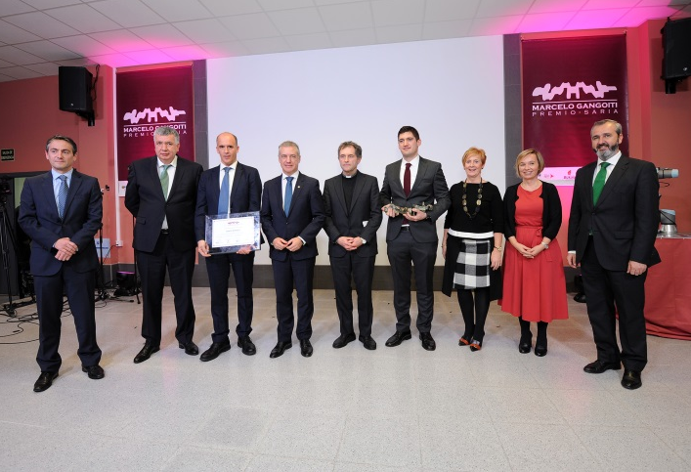
Marcelo Gangoiti Award
1996
1997-2008
2008-2020
2022
Mebunik
Samper
Gosan
Onduline
Lehoiko Biotz
ICT-ICM
Precicast Bilbao
Troquevi
DIC Coatings
Autonervión
Inkoa
Astilleros Zamakona
MIESA
25. EDITION
IMAR
Jota+ge
Petronor
Tecuni
Tamoin
Navacel
Bombardier
Metso
Prosertek
Lancor
Emica bombas
FIRST EDITION

Slide 33
Strategic Alliances and Networks
Association of Basque Vocational Training Centres for Social Initiative
Vocational Training Innovation Centre
Diocesan Centers
National Association of Vocational Training Centres

Slide 34
Other Alliances

Slide 35
Add your detail text here. This is the placeholder column
International Projects
Its seeks to improve the abilities of caregivers of people suffering from dementia and Alzheimer
The aim of the project is to create new training contents related with microgrids, this new energy spectra based on renewable energies on a global basis.
02
03
CASE
MICROGRIDS
Training for adult educators to acquire the technical and transversal knowledge required to apply VR and AR technologies in the classroom
01
This project pretends to create an app for low qualified people to work on basic skills such as numeracy, literacy, and other soft skills
VIRAL SKILLS
04
PLAY YOUR SKILLS

Slide 36
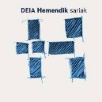
Awards
GOLDEN A FOR ADVANCED MANAGEMENT
The award granted by the Basque Government through EUSKALIT after an evaluation focused on five key elements in management: Strategy, Customers, People, Society and Innovation.
CENTRO FARO PARA LA TRANSFORMACIÓN SOCIAL
Named by Unesco Etxea as a 'Lighthouse Centre' for its choice of Education for Social Transformation.
PREMIO QUALITY INNOVATION AWARD
Prize in the Innovation in the Education sector category, in the Euskadi phase
PREMIO NACIONAL DE APRENDIZAJE Y SERVICIO
Development Cooperation Award for our project "RECYCLING WITH HAHATAY"
PREMIO EUSKALIT DE BUENAS PRÁCTICAS
SDG Integration in Organisations Award
PREMIO DEIA HEMENDIK SARIA
Recognition for work and social work in the mining area
SELLO STEAM EUSKADI
For contributing to making the Basque Country a more innovative territory with our projects to promote STEAM Education.
GORAKIDE
Recognition for commitment to people with intellectual disabilities
SELLO ENKARTERRI GREEN
Enkarterri Green recognises our corporate social responsibility model
STARTINNOVA
Different entrepreneurship awards for the projects presented by our VET students.

Slide 37
Thank you for
your attention!
europe@somorrostro.com

